Slide 1
Local Government Business Model
Notes:
Here’s a description of the esd-toolkit Local Government Business Model , which is being published at http://doc.esd.org.uk.

Slide 2
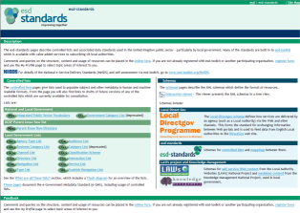


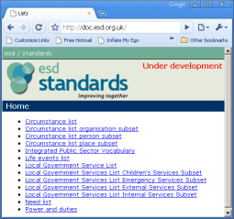
Revamping esd-standards
CI and BI work
Notes:
The new site at http://doc.esd.org.uk remodels the existing esd-standards site using the outputs of workshops with CI and BI AND employing elements of the public sector object model and techniques for publishing as linked data according to the rules for public sector URIs. These are two technical aspects of the Standards and Architecture Framework being published this month by the Cabinet Office. (You needed worry too much about these unless you are interested in Linked Data.)

Slide 3
People and places
Life event
Changes
Determines
Implies
Addresses
Circumstance
Need
Service
Impacts on
Defines eligibility for
Impacts on
Defines
Outcome
(PI)
Life event
Circumstance
Need
Service
Becoming unemployed
Employment & training initiatives
Unemployed
Employment
Notes:
There are three animated slides showing LGBM in three parts. The first is the most relevant to Customer Insight.
Each oval/elipse represents a controlled list.
Each line connecting two ovals defines the relationships between controlled lists.
Along the bottom you see an example of related items from different lists. The text acts as hyperlinks to where these items (life events, circumstance, need, etc) are defined.
(From here the slide should be self-explanatory.)

Slide 4
Organisation scope
Function
Is part of
Performs
Service
Power/Duty
Organisation type
Confers on
Allows/ Requires
Confers
Legislation
Org. type
Function
Service
Duty
Legislation
County council
Education
Primary school places
Secure efficient education
Education Act 1996 section 13
Notes:
The same rules apply to the “organisational scope” part of LGBM.
Note that services are now linked online to the legal powers and duties under which they are delivered. These in term link live to definitions of the relevant legislation supported by OPSI (the Office of Public Sector Information), which is adopting the same Government IT architecture.

Slide 5
Organisation
Accessed from
Service
Has
Web menu structure
Record classification
Delivered via
Conducted via
Same as
Contains
Channel type
Process
Document type
Interaction type
Service
Process
Interaction
Channel
School clothing grants
Provide information
Receive application
Verify…
Provide information
Application
Web
Phone
Face to face …
Notes:
The ‘organisation’ part of LGBM defines how services are delivered. It supports business improvement work – particularly Activity Based Costing.

Slide 6



People and places
Organisation scope
Life event
Function
Changes
Determines
Implies
Addresses
Is part of
Performs
Circumstance
Need
Service
Power/Duty
Organisation type
Impacts on
Defines eligibility for
Confers on
Impacts on
Allows/ Requires
Confers
Defines
Outcome
(PI)
Legislation
Implies preference for
Delivered via
Retention defined by
Accessed from
Has
Web menu structure
Process
Record classification
Has
Grouped by
Same as
Contains
Interaction type
Conducted via
Document type
Local Government Business Model (LGBM)
© esd-toolkit 2009
Diagram may be re-used subject to crediting the source as esd-toolkit
Channel type
Organisation
Notes:
This rather scary diagram shows the entire LGBM with the three parts brought together and a few links between them.
esd-toolkit aims to publish and maintain a controlled list for every oval except:
legislation, which is maintained by OPSI
Outcomes, as defined by NIs. CLG plans to do this and we should be able to use the same methods as they do to define local indicators
We hall publish links (mappings) between items in each list, as reflected by every line on the diagram.
About half of this is now in place online, including CI lists for:
life events
circumstance
needs

Slide 7
More information
http://doc.esd.org.uk/
E-mail: Support@esd.org.uk
Notes:
That’s it.
Have a play online and contact us with queries and/or change text and make comments online.
Over time further features will appear. We expect it to be live at the end of the year after review by local authorities as part of the esd-toolkit Key Information working group work.

